Slide 1
Health and Security of FOSS Supply Chain
Justin Chao
March 30, 2020

Slide 2
Global Supply & Demand for FOSS

Slide 3
Global Supply & Demand for FOSS
The Economics of FOSS
80-90% of any given modern application is comprised of open source software.
Heavy reliance on FOSS is common in both the public and private sectors, tech and non-tech companies alike.
Ensuring the health and security of FOSS Supply Chain is critical to the future of nearly all industries in the modern economy.
Notes:
Understand what components are being used, and how well they are being maintained and supported.

Slide 4
Global Supply & Demand for FOSS
Software Supply Chain
Notes:
Traditional manufacturing-based supply chains have trusted suppliers who build components used in the final assembly of the finished product.
Traditional supply chains have also streamlined logistics and sourcing by using large, centralized warehouses to store and distribute those components with more security and efficiency.
Toyota has a limited set of trusted suppliers in their supply chain.
They know exactly where their parts are coming from, who created them, and what cars they are going into.
Because of that knowledge, they can trace any defects or safety issues that arise back to the source.
Understanding what components are used, where, and how they are being used is difficult because…

Slide 5
Global Supply & Demand for FOSS
Economics of FOSS
Today’s development ecosystem is very complicated because of the amount of components out there.
Most if not all components have transitive dependencies.
Number of OSS projects coming to market every day is sharply increasing each year.
Notes:
1,096 new projects per day
10,000 new versions per day
14x releases per year

Slide 6
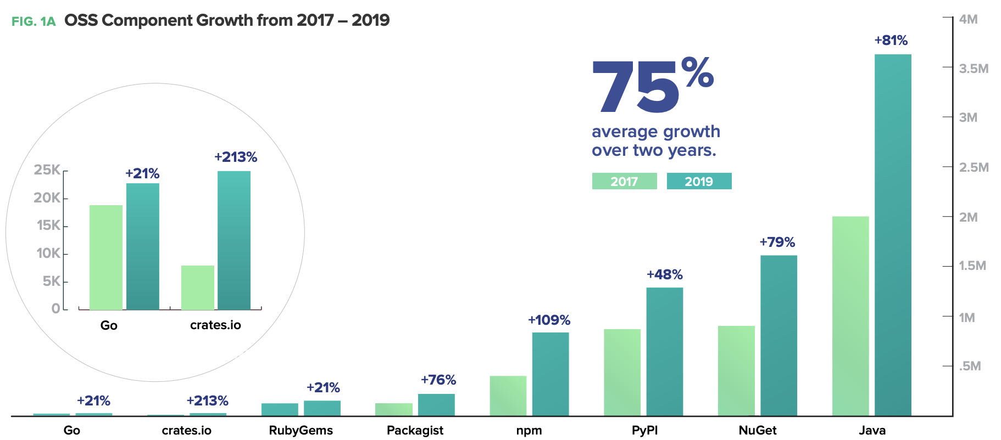
Global Supply & Demand for FOSS
Notes:
SUPPLY
3.7 million unique Java open source software component releases in the Central Repository
800,000 unique JavaScript packages in npm
1.2 million unique Python component releases housed in the PyPI repository
1.6 million .NET component releases in the NuGet Gallery.
> 2.2 million containerized applications housed in Docker Hub — up from 900,000 the previous year.

Slide 7
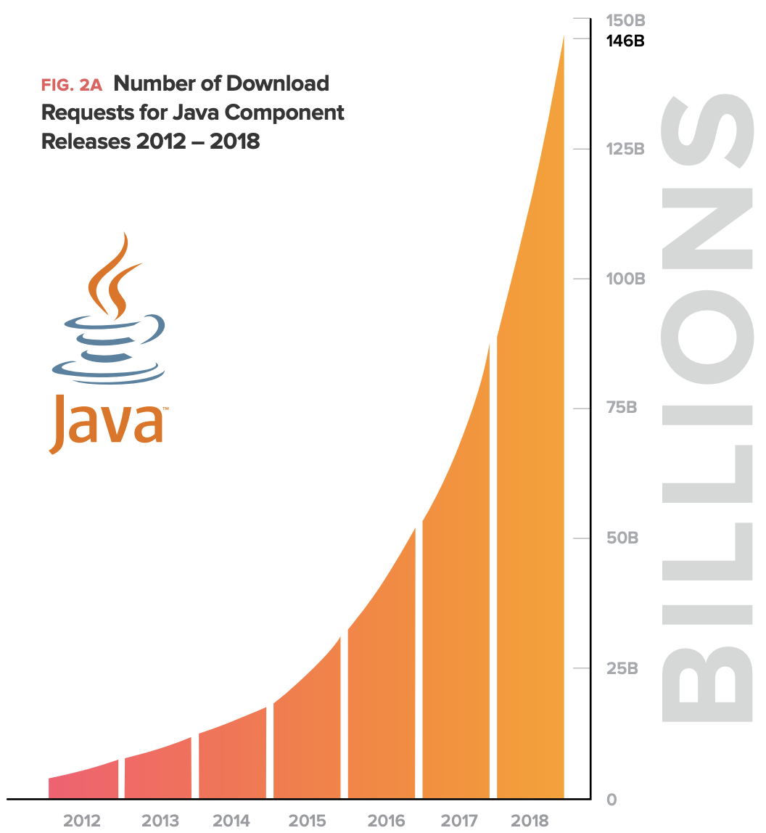
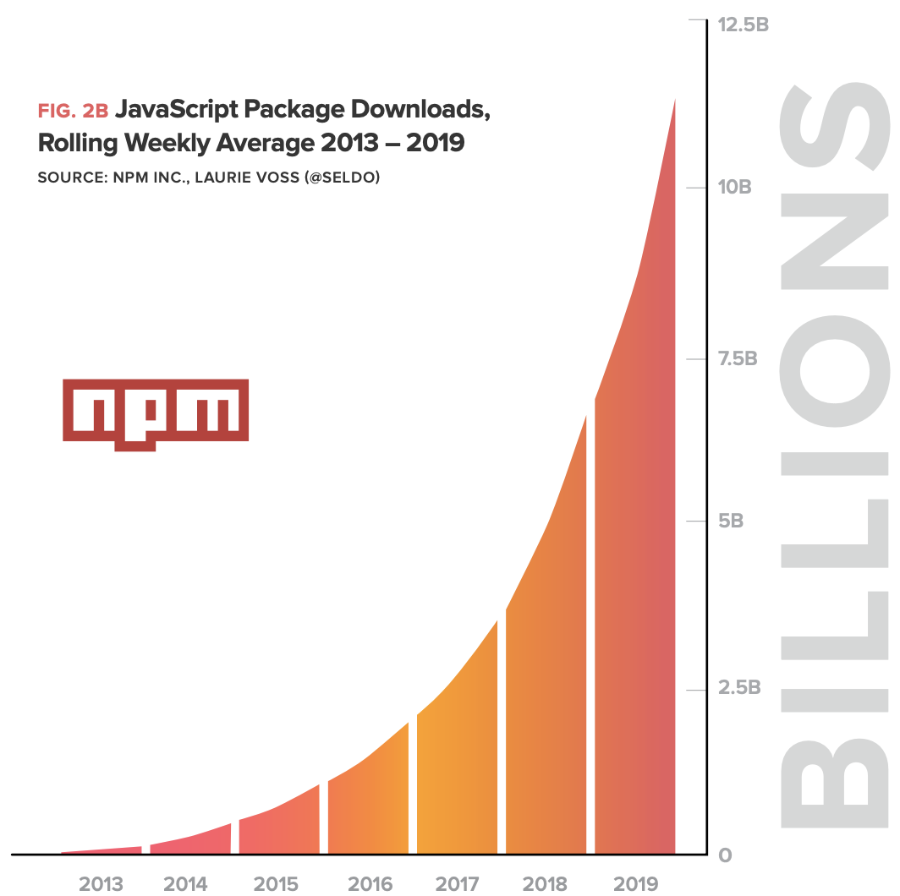
Global Supply & Demand for FOSS
Notes:
DEMAND
2018 - download requests for Java component releases from the Central Repository grew 68% year over year to 146 billion.
estimated 12 million Java developers around the world, this equates to 12,166 per person
2018 - average weekly npm package downloads increased from approximately 3.5 billion to 10 billion — an increase of 185%
estimated 9.7 million JavaScript developers in the world - average JavaScript developer is sourcing 1,030 packages per week or 53,608 packages per year
DEMAND for Innovation -> DEMAND for FOSS -> fuels Rapid Innovation (FOSS freely copied and modified) -> SUPPLY new versions and releases

Slide 8
Vulnerability Incidents

Slide 9
Heartbleed Vulnerability
2014 - Security bug in the OpenSSL cryptography
Impacted nearly 20% of secure web servers on the Internet (almost half a million servers).
Allowed attackers to obtain access to user passwords and session cookies.
Theft of 4.5 million medical records from a large hospital chain.
Notes:
OpenSSL is a software library that implements the SSL (secure sockets layer) and TLS (transport layer security) web security protocols.

Slide 10
Repackaging of Xcode for Malicious Code Distribution
2015 - “XcodeGhost”
39 applications available through the App Store were infecting iPhones and iPads.
Malicious applications connected to remote command-and-control servers and uploaded sensitive user information as part of a botnet.
Inserted into the applications through a “repackaged” version of Apple’s official development platform Xcode.
Notes:
Xcode-lookalike would add the botnet code alongside the otherwise legitimate apps developed using the platform.
XcodeGhost’s creators repackaged Xcode installers with the malicious code and published links to the installer on many popular forums for iOS/OS X developers.
Developers were enticed into downloading this tampered version of Xcode because it would download much faster in China than the official version of Xcode from Apple’s Mac App Store.
When the developers installed what they thought was a safe Apple dev tool, they actually got a tampered version that would compile the malicious code alongside their actual app’s code.

Slide 11
“left-pad” Dependency Incident
2016 - Jenga tower of JavaScript
Dispute about naming rights caused a well-known developer to remove 273 packages from npm.
left-pad right-justifies text for more human-readable text output.
Relied upon by a number of critically important downstream packages - including Babel.
Notes:
Babel - “cleans up” and updates JavaScript code during the compilation process.
Widespread “transitive dependency” issue, where developers who had no idea and no intention to rely upon left-pad were also affected due to the package being nested within their upstream dependencies.

Slide 12
Python Package (PyPI) Highjacking
2017, 2018
Malicious libraries with names that “closely resembled” the names of built-in Python libraries.
Installation script was changed to include malicious code.
Crytocurrency-stealing Python package called “Colourama”.
Legitimate package “Colorama,” one of the top-20 most-downloaded pieces of software within PyPI.
Notes:
Similar incident to XCodeGhost.

Slide 13
Backdooring of “event-stream” Library
2018
Cryptocurrency-stealing code inserted into the package.
Malicious actors obtained legitimate publishing rights to the package itself by offering help to the beleaguered original developer.
Benign package, “flatmap-stream”, added to npm.
flatmap-stream added as a dependency to event-stream.
Malicious code added to flatmap-stream.
Notes:
event-stream library had been downloaded 2 million times at the time of the backdoor’s discovery.

Slide 14
Account Takeover of Popular Ruby Gems Package
July 2019
strong_password, had been updated from 0.0.6 to 0.0.7, with code discrepancies b/w Github and Ruby repository.
Malicious code would contact a remote URL and retrieve additional code for remote code execution.
Ruby repository account had been taken over.
Notes:
Developer updating their codebase noticed a missing changelog.md file in one of their dependencies.
- lesson: have a changelog.md
A malicious actor had compromised the maintainer’s account, shifted ownership of the package, and then published the backdoored code.

Slide 15
Webmin Compromise
2018 - 2019
Webmin is a web-based interface for system administration for Unix.
Backdoor leveraging a specially-crafted URL to send commands to infected servers, which would then execute the commands with root privileges.
Server logs altered so that it looked like the file had not been updated in some time, hiding the change from common detection mechanisms like code comparison tools.
Notes:
Server containing the Webmin source code was exploited in April 2018, allowing malicious code to be inserted.
August 17, 2019 - outside party discovered that the backdoor had been released as part of a 0-day exploit.
A zero-day (0day) exploit is a cyber attack targeting a software vulnerability which is unknown to the software vendor or to antivirus vendors.

Slide 16
Discovery of 11 Backdoored RubyGems Libraries
August 2019
Allowed malicious actors in possession of pre-chosen credentials to remotely execute code on infected servers.
At least one of the packages infected due to the compromise of a developer account.

Slide 17
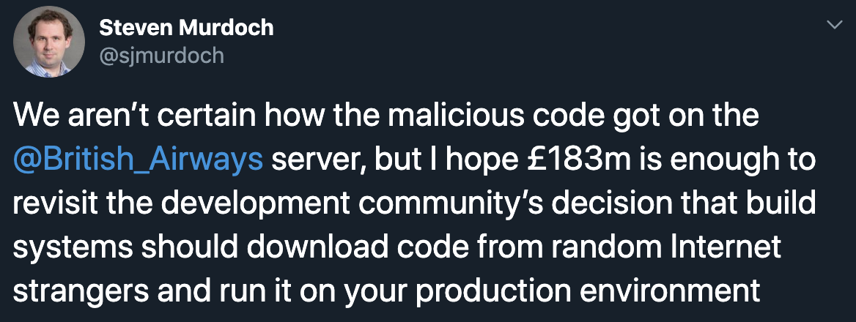
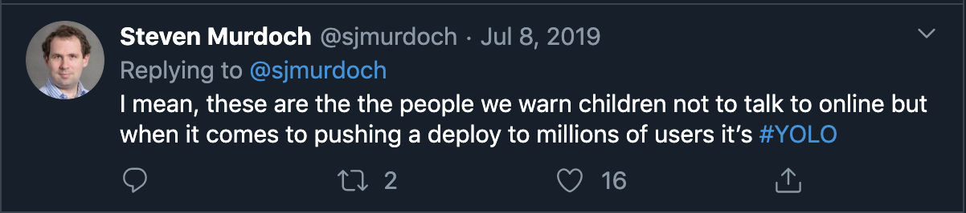
British Airways fined $237M
2019
Notes:
These incidents have consequences that go beyond the technical.
Javascript vulnerability on website diverted payment details to separate website (baways.com).
Infringements of the General Data Protection Regulation (GDPR).
But - Did we learn?

Slide 18
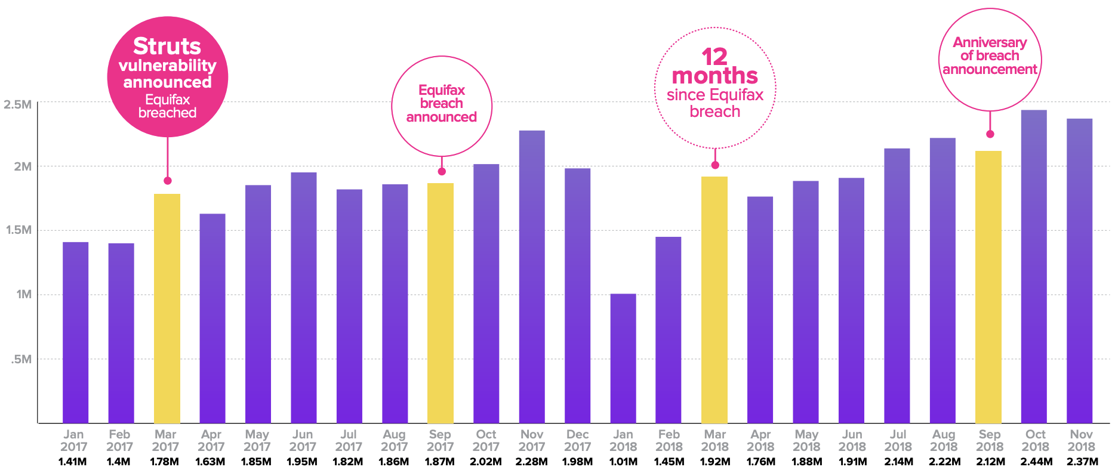
Post-Equifax
“the internet never forgets”
Notes:
Graph: Vulnerable Struts Download Counts January 2017 – November 2018
According to Fortinet’s Q4’2018 Threat Report, vulnerable instances of Apache Struts remain the most prevalent exploit.
Apache Struts exploit (associated with CVE-2017-5638) has been a top detection since its role in the infamous Equifax breach back in 2017
1 year after the breach announcement, monthly vulnerable Struts downloads had increased 11% to 2.1 million.

Slide 19
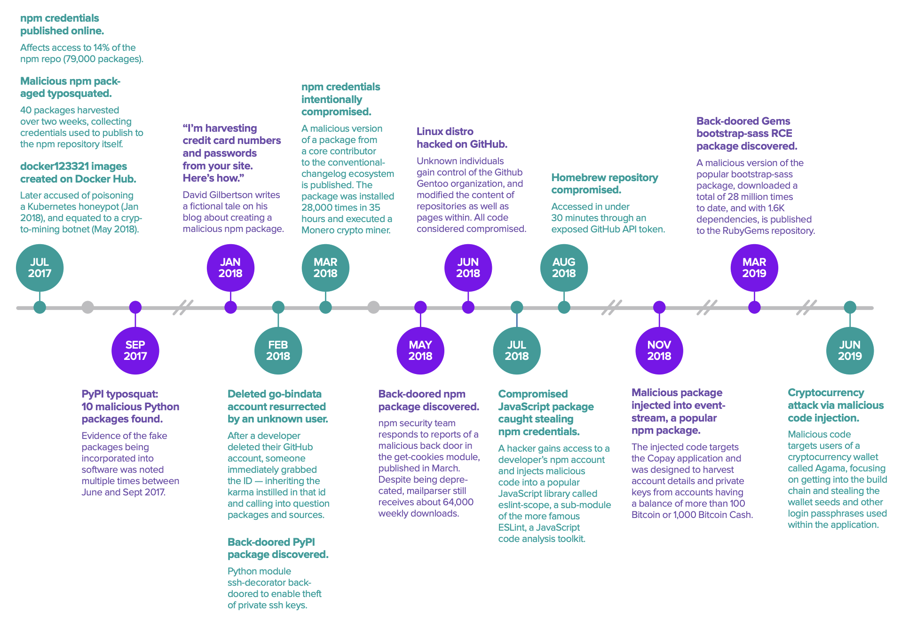
Shifting Battlefront
Notes:
Over the past 2 years, a dangerous new trend has emerged.
Adversaries are taking advantage of a new attack vector where they are directly injecting vulnerabilities into open source project releases and container images.

Slide 20
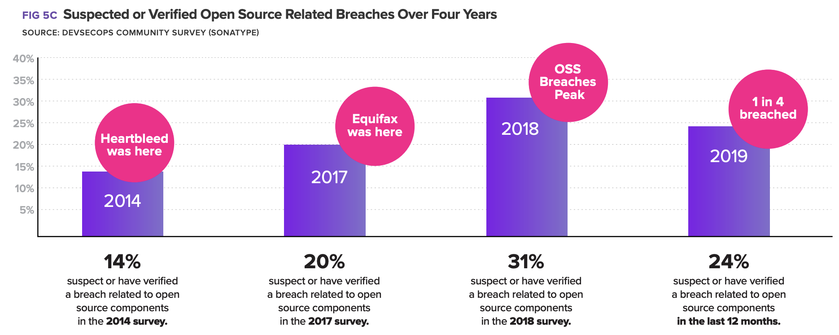
Increasing attacks on Open Source
Notes:
71% increase in confirmed or suspected open source related breaches since 2014.
7% decline in may be attributed to improved open source hygiene and investments made by some organizations following the Equifax breach (made public in late 2017)

Slide 21
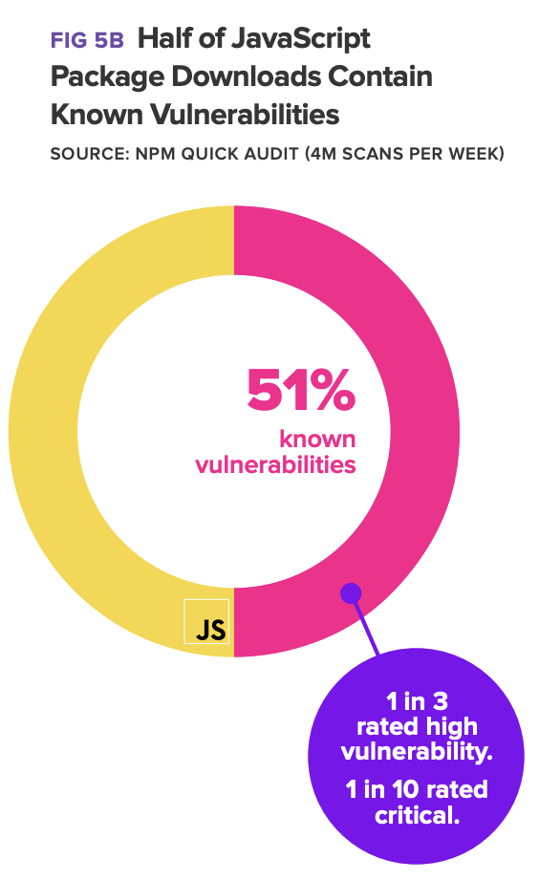
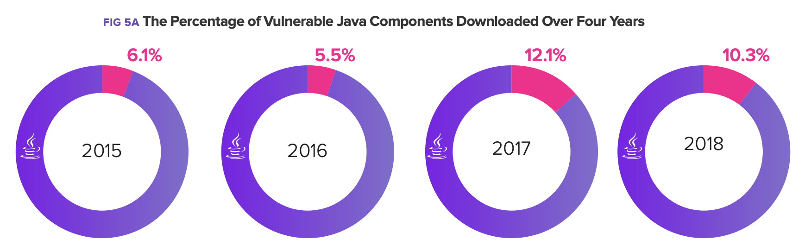
Increasing attacks on Open Source
Notes:
Another graph specific to java and javascript.

Slide 22
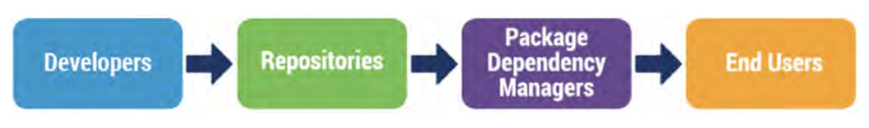
So, what’s can be done?
Notes:
Keep in mind, the image of a supply chain…

Slide 23
Developer Practices
Use 2FA/MFA for developer and other important accounts.
Require change control tracking throughout SDLC.
Use unique version identifier for each release.
Cryptographically sign or present verifiable proof of a project’s integrity.
Integrate testing into SDLC to check common bugs, unexpected behavior, and malicious changes.
Leverage tools to track, analyze, and manage dependencies.
Document project dependencies in a way that is readily consumable by downstream users.
Notes:
Use unique version identifier for each release, so downstream users can track new releases and establish controls and verification mechanisms around them.
- CNCF: Notary and TUF (The Update Framework)

Slide 24
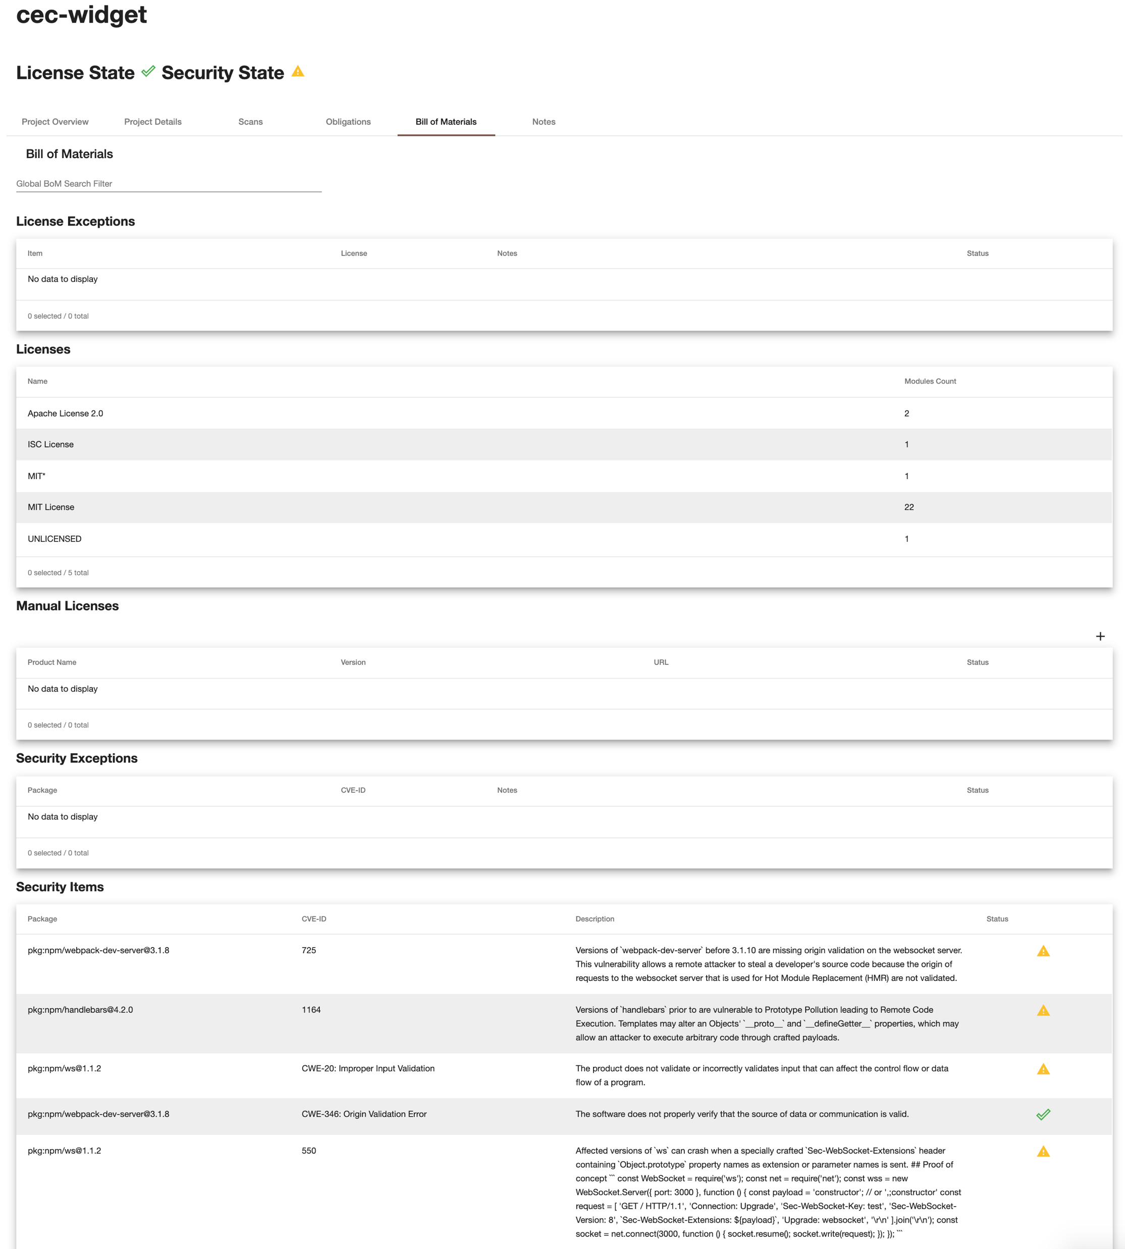

Slide 25
Repositories
Language repositories lack basic security and quality controls
Few language repositories currently provides for a mechanism through which stored code is examined for its purpose.
Few language repositories perform systematic checks for vulnerabilities in stored code or for deprecated packages.
No language repository currently provides for a mechanism through which a consumer can tell if one piece of stored code is derived from another.
In most language repositories, weak or missing authentication and publisher verification mechanisms create uncertainty and risk over the provenance of stored code.
Some language repositories do not provide 2FA/MFA of developer accounts.
Notes:
While some language repositories have taken steps to address subsets of these concerns, no repository has developed mechanisms for addressing them all.
Further, for some language repositories that have attempted to address these concerns, many have chosen to do so by “commercializing” the repository itself, whereby paying customers receive “premium” features like those listed above.
Consequently, many basic and necessary security and quality controls remain outside the reach of many everyday consumers

Slide 26
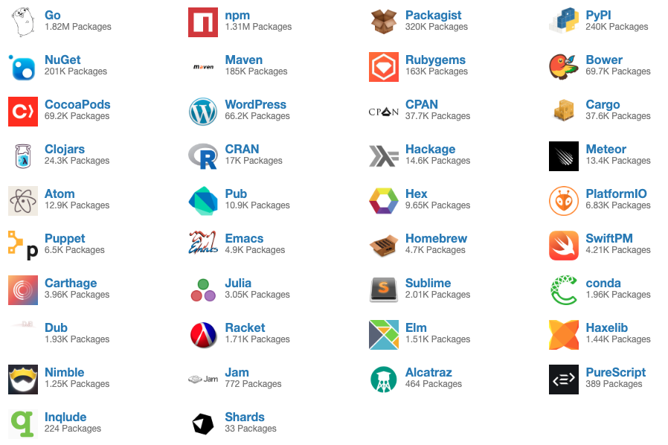
Project Dependency Managers
Package Managers
PDMs are simply software retrieval tools.
No checks on if retrieved software has known security or reliability issues.
No checks on if retrieved software contains unexpected or malicious behavior.
Notes:
Instead, these practices should be—but as discussed above, usually aren’t—performed within other parts of the software supply chain, frustrating efforts by PDM users and PDM maintainers themselves to ensure some degree of security and quality within retrieved software.
Usage of Vulnerability Databases instead…

Slide 27
Vulnerability Databases
Common Vulnerabilities and Exposures (CVE) & the National Vulnerability Database (NVD) programs
Missing or rejected vulnerabilities, leading to incomplete coverage in the NVD.
Severely delayed assignment of vulnerability identifiers, creating risks for downstream parties who remain unaware and likely unprotected from the issue.
Poorly contextualized descriptions of vulnerabilities, increasing the difficulty of mitigation and vulnerability management.
Overinflated and/or underplayed vulnerability scores, leading to misallocated resources and in some cases vulnerability “fatigue.”
Difficulty in revoking assigned vulnerabilities when they are found to be invalid, creating confusion and lack of trust in overall program.
Notes:
The NVD is considered so important that in 2018 it was exempted from the U.S. government shutdown.
Over 6,000 vulnerabilities went unassigned by MITRE’s CVE project in 2015,

Slide 28

Vulnerability Databases
Social Issues with CVE and NVD
Abuse by developers who claim inflated numbers of vulnerabilities in order to pad resumes, creating “false positives.”
Abuse by engineers in organizations who see CVE assignments as a way to circumvent difficult management procedures preventing them from doing normal software upgrades.
Discomfort with the CVE program because it is managed by a US federal agency.

Slide 29
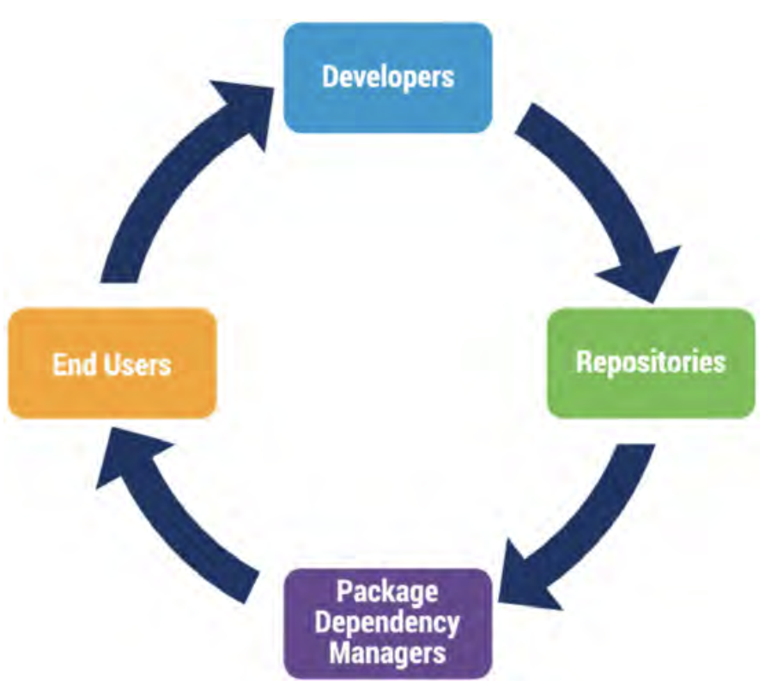
End User Practices
Define and control acquisition requirements
Require that dependency lists, software bills-of-material, or other such component tracking mechanisms are provided in a robust and transparent way.
Vulnerabilities within products maintained by a technology provider that are judged to have specific impacts must be remediated within certain timeframes.
Developers must use 2FA or MFA with any accounts related to the development of the software being acquired.
Notes:
Example: OpenShift vs Kubernetes

Slide 30
Government and Industry Standards
What software components are being used, and how well they are supported?

Slide 31
Government and Industry Standards
U.S. Food and Drug Administration
Cybersecurity Bill of Materials (CBOM) for medical devices.
“to effectively manage assets, to understand the potential impact of identified vulnerabilities to the device, and to deploy countermeasures to maintain the device’s essential performance.”
MDMs may be subject to legal liabilities tied to the distribution of a medical device with a known vulnerability.
Notes:
October 2018 - FDA released guidance for cybersecurity management of medical devices.
The FDA report also suggested that MDMs may be subject to legal liabilities tied to the distribution of a medical device with a known vulnerability.
The report offered, “If a medical device cybersecurity vulnerability allegedly causes bodily harm, the victim may bring product liability claims against the MDM.”
The FDA warned that a plaintiff’s claim could be based on the “failure to provide appropriate warnings about the risk of a cybersecurity vulnerability, or failure to appropriately monitor for the existence of vulnerabilities and appropriately address them once identified.”47

Slide 32
Government and Industry Standards
U.S. House Energy and Commerce Committee
Cybersecurity Strategy Report details importance and priority for SBOM.
Permits risk decisions about which tech to purchase/use based on known vulnerability info.
Allows for quick identification & response to new vulnerabilities.
Minimizes the number of unknown unknowns.
Notes:
December 2018 - the U.S. House Energy and Commerce Committee released its Cybersecurity Strategy Report.

Slide 33
Government and Industry Standards
Payment Card Industry Security Standards Council
360 degree monitoring of open source component releases through SDLC.
Up to date inventory of open-source component releases utilized in software.
Process for identifying known vulnerabilities within open source component releases.
Policy and process to immediately remediate vulnerabilities as they become known.
Notes:
2019
PCI Secure Software Standards
PCI Secure Software Lifecycle (Secure SLC) Standard

Slide 34
Government and Industry Standards
National Telecommunications and Information Administration (NTIA)
Requiring companies to list sources of software parts to protect U.S. software supply chains.
Focus on “Software Component Transparency” across manufacturers and vendors.
Defining standards around SBOM.

Slide 35
Community Efforts
What software components are being used, and how well they are supported?

Slide 36
Linux Foundation - Core Infrastructure Initiative (CII)
Census Project (“Census I”)
Identify which software packages in the Debian Linux distribution were the most critical to the kernel’s operation and security.
Did not delve deeply into what software was deployed in production applications.
Notes:
2015 - Census I

Slide 37

Linux Foundation - Core Infrastructure Initiative (CII)
Census II
Identify the most commonly used free and open source software components in production applications.
Examine for potential vulnerabilities in these projects due to:
Widespread use of outdated versions
Understaffed projects
Known security vulnerabilities
Prioritize investments/resources to support the security and health of FOSS.
Notes:
2018 - Linux Foundation partnered with the Laboratory for Innovation Science at Harvard University (LISH) with the goal of conducting a second census to identify and measure how widely open source software is deployed within applications by private and public organizations.
Allows for a more complete picture of FOSS usage by analyzing usage data provided by partner Software Composition Analysis (SCA) companies.
Software Composition Analysis (SCAs) data focuses on lower level components that act as the building blocks for other software products.
CHAOSS = Community Health Analytics Open Source Software

Slide 38
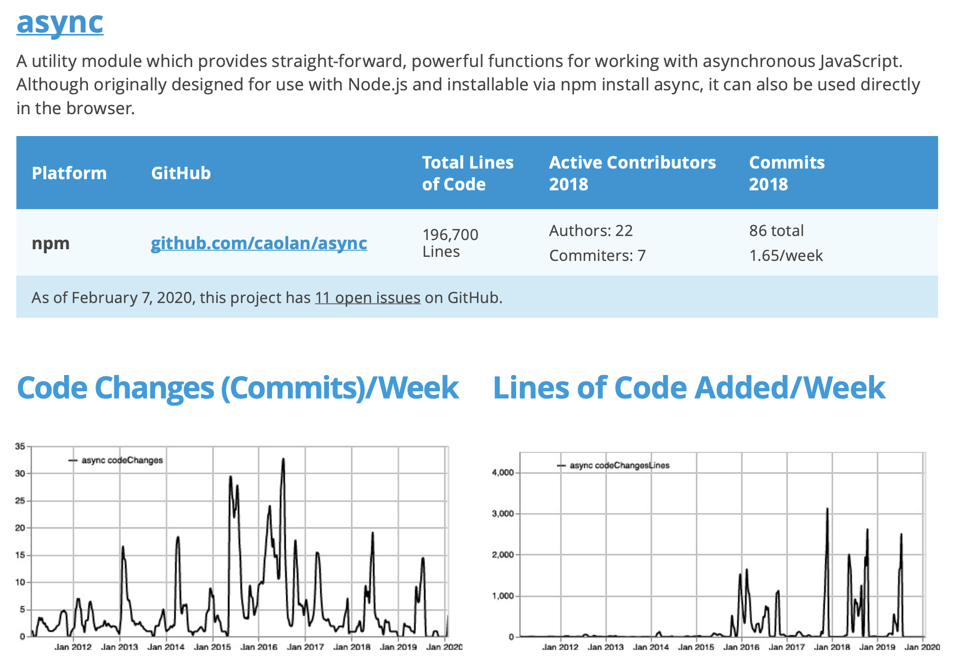
Linux Foundation - Core Infrastructure Initiative (CII)
Notes:
Software Composition Analysis (SCAs) data focuses on lower level components that act as the building blocks for other software products.

Slide 39
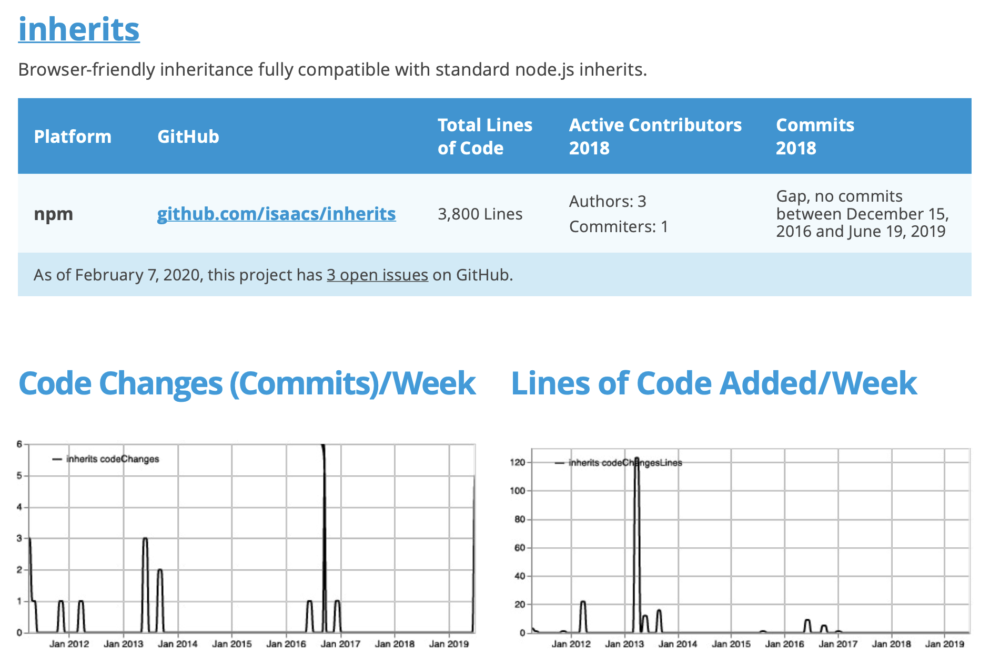
Linux Foundation - Core Infrastructure Initiative (CII)

Slide 40
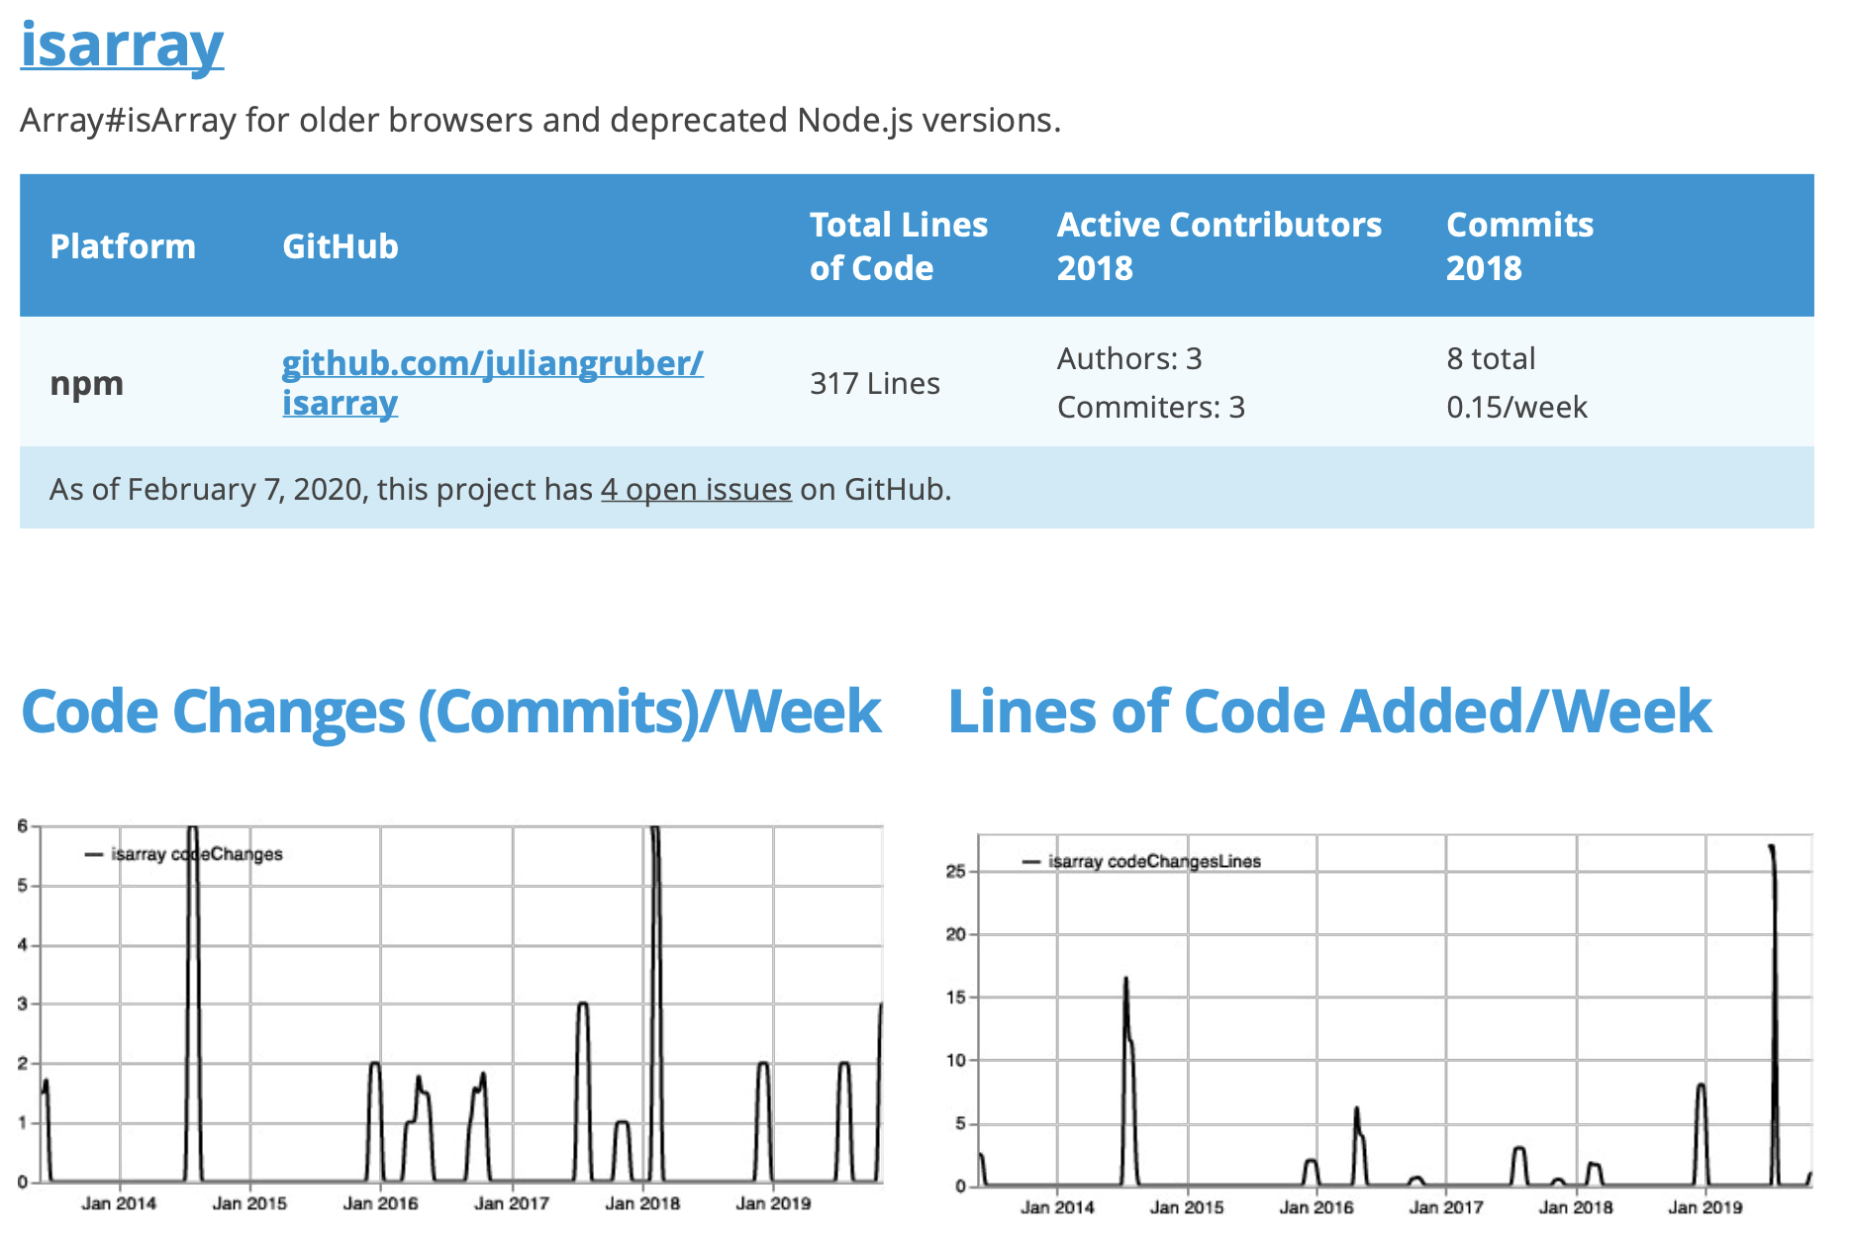
Linux Foundation - Core Infrastructure Initiative (CII)

Slide 41
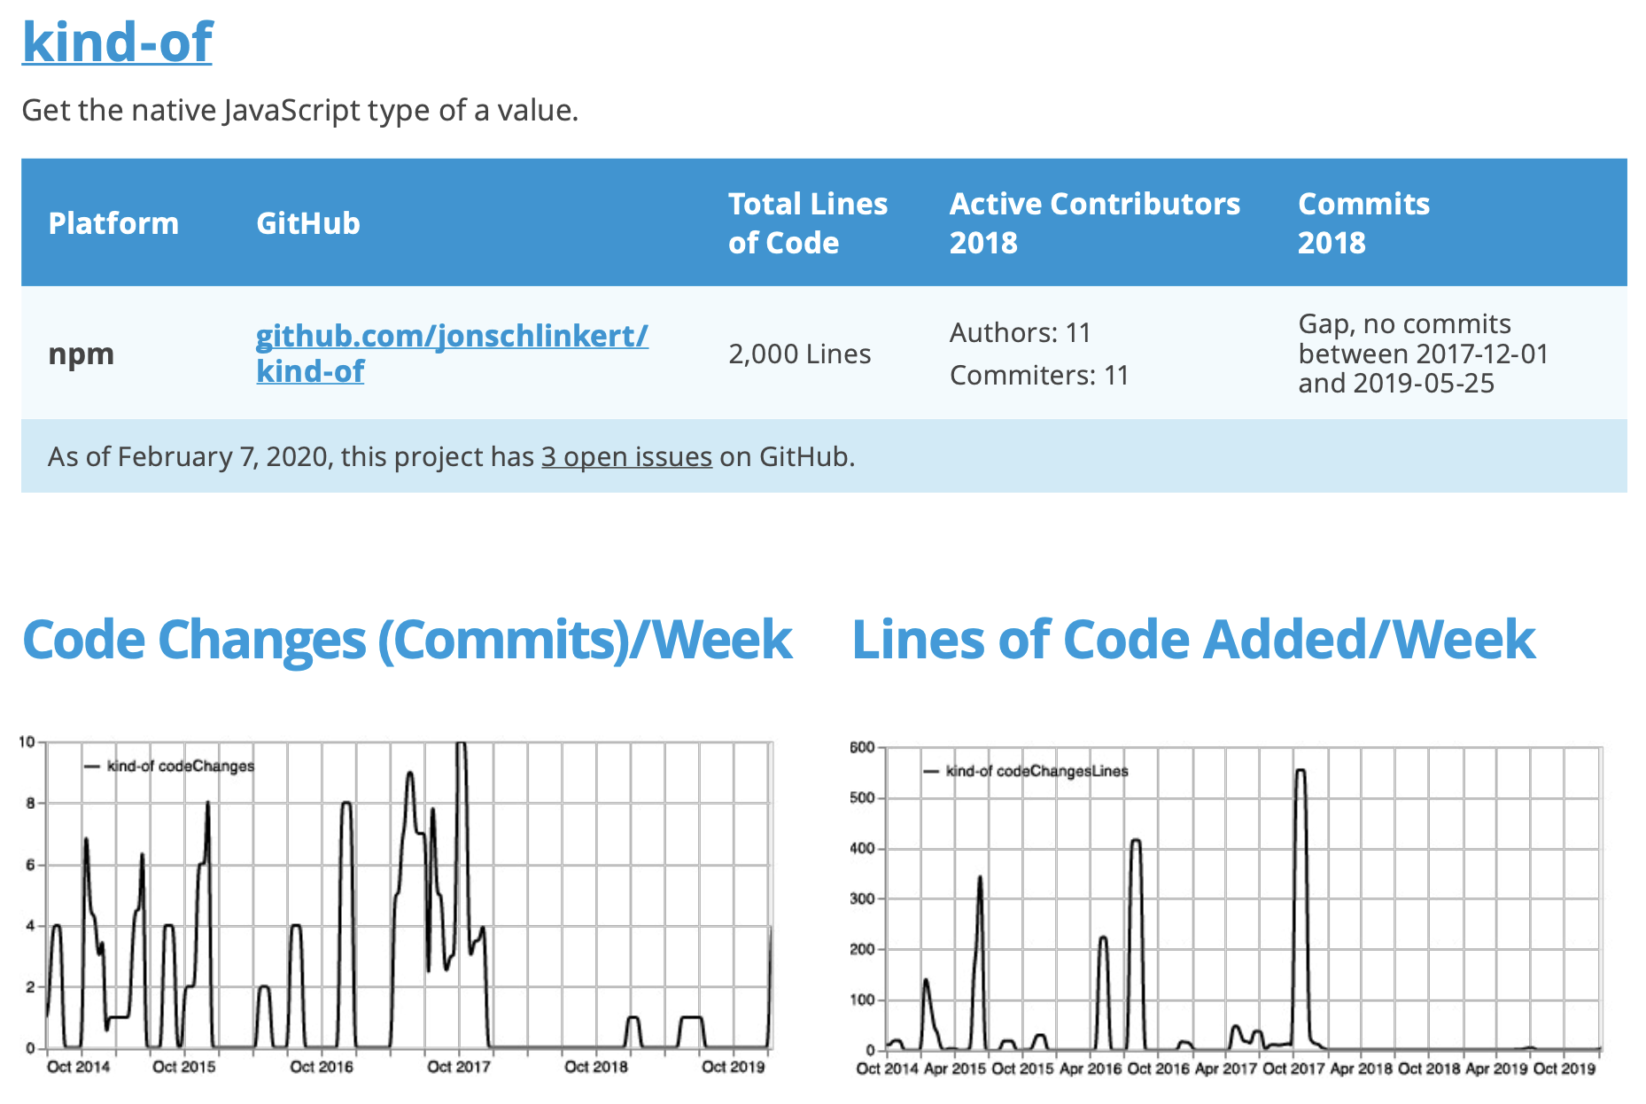
Linux Foundation - Core Infrastructure Initiative (CII)

Slide 42
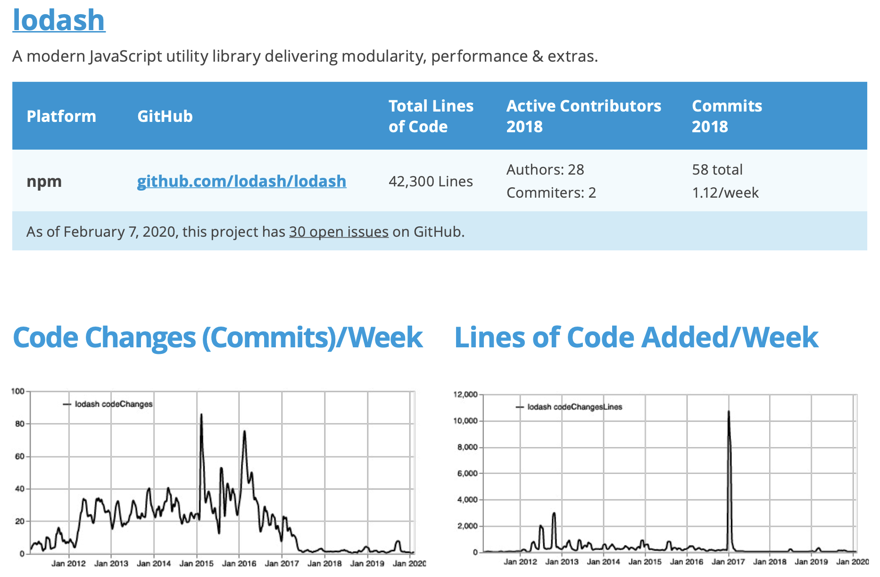
Linux Foundation - Core Infrastructure Initiative (CII)

Slide 43
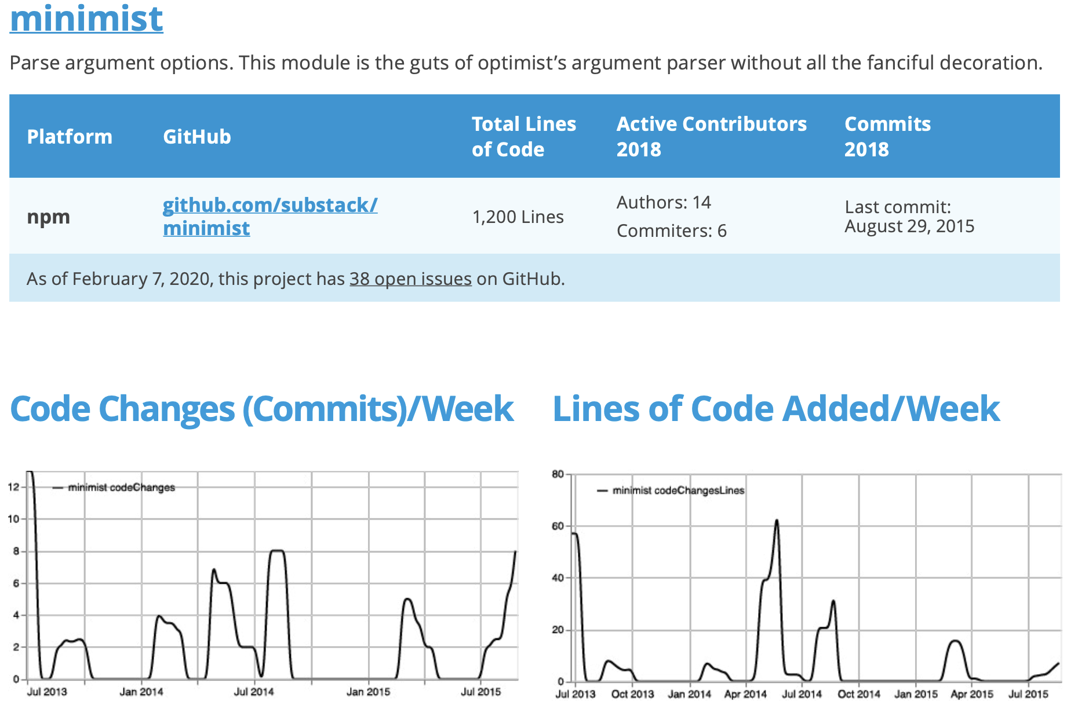
Linux Foundation - Core Infrastructure Initiative (CII)

Slide 44
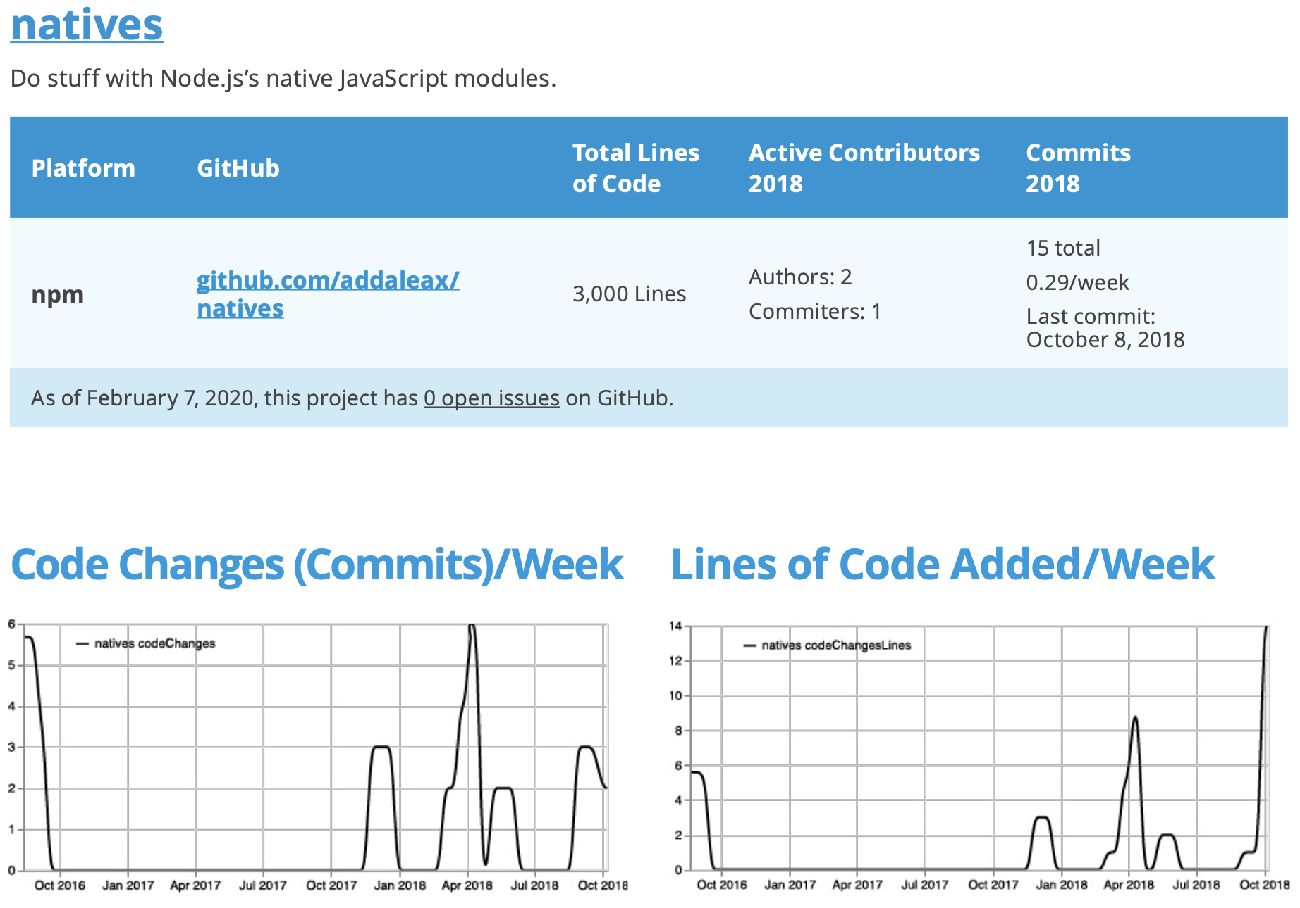
Linux Foundation - Core Infrastructure Initiative (CII)

Slide 45
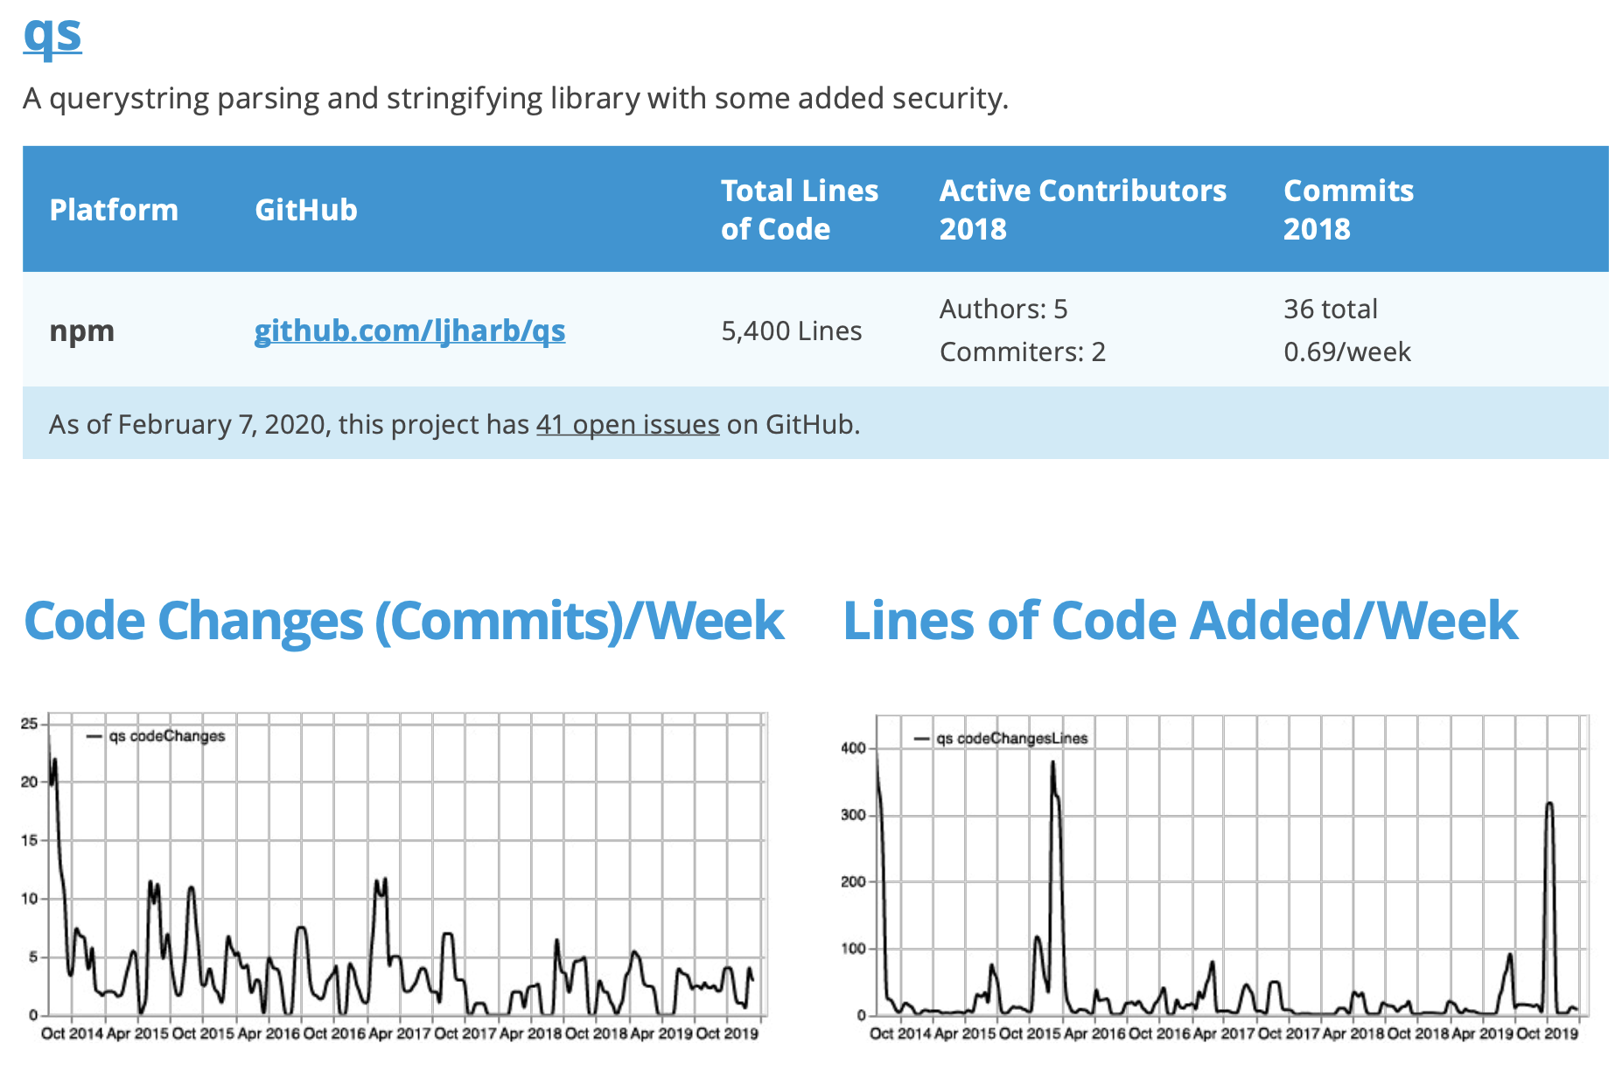
Linux Foundation - Core Infrastructure Initiative (CII)

Slide 46
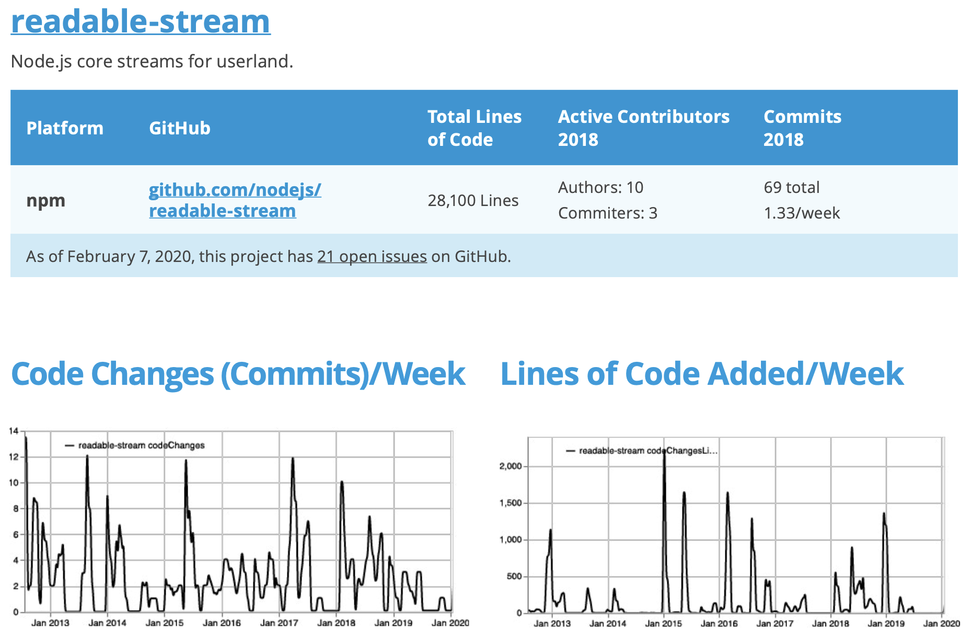
Linux Foundation - Core Infrastructure Initiative (CII)

Slide 47
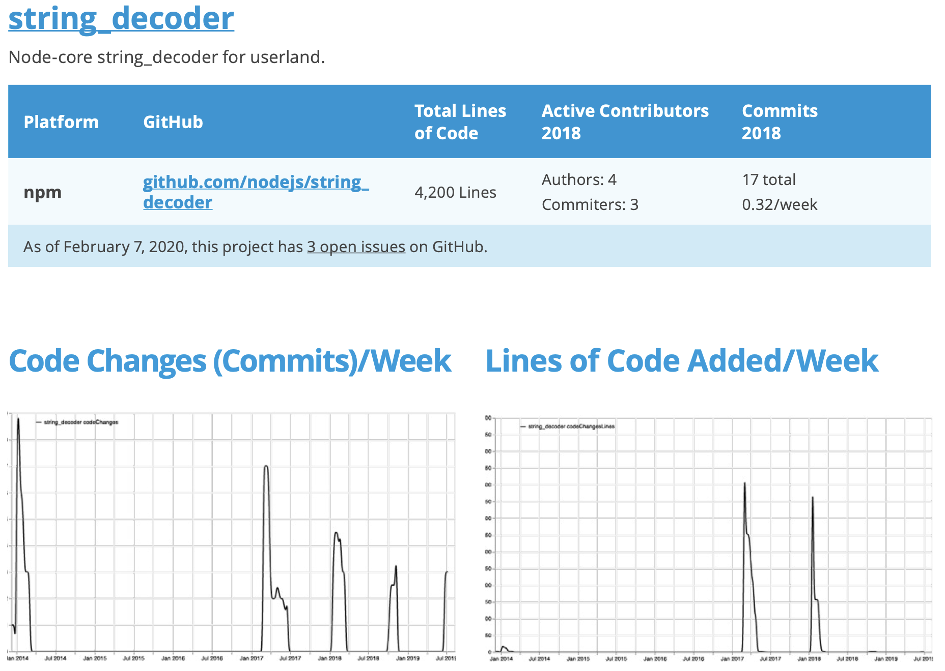
Linux Foundation - Core Infrastructure Initiative (CII)

Slide 48
Linux Foundation - Core Infrastructure Initiative (CII)
Preliminary Findings
High correlation b/w being employed and being a top contributor.
2017 GitHub data found that some of the most active FOSS developers contributed to projects under their Microsoft, Google, IBM, or Intel employee email addresses.
The need for standardized naming schema for software components, for software supply chain transparency and security efforts.
7/10 of most used software packages are hosted under individual developer accounts.
The persistence of legacy software in Open Source.
ie: “yargs” vs “minimist”
Notes:
By manually cross-referencing public GitHub profile information with data sources like LinkedIn, Crunchbase, and other publicly-available data from social media and networks, company affiliations for the majority—over 75%—of the top committers could be determined.
Contrary to popular image in open source discussions of “the overworked and underpaid programmer,”
Even if the contributors to the projects listed in the appendices do not receive direct compensation from private companies to develop these packages, their status as a member of the FOSS community could have endorsed their qualifications for their current paid employment.
Standardized naming schema for data collection, analysis, and SBOM efforts by community, industry, and government bodies.

Slide 49

Linux Foundation - Core Infrastructure Initiative (CII)
Best Practices Badge Program
Document how to install and run (securely), and any API.
Have a distributed public version control system, including changes between releases.
Respond to bug reports within 14 days, and fix vulnerabilities.
Have an automated test suite that covers most of the code/functionality, and officially require new tests for new code.
Support HTTPS on the project sites.
Notes:
Significant achievement: On average only about 10% of pursuing projects have a passing badge.

Slide 50
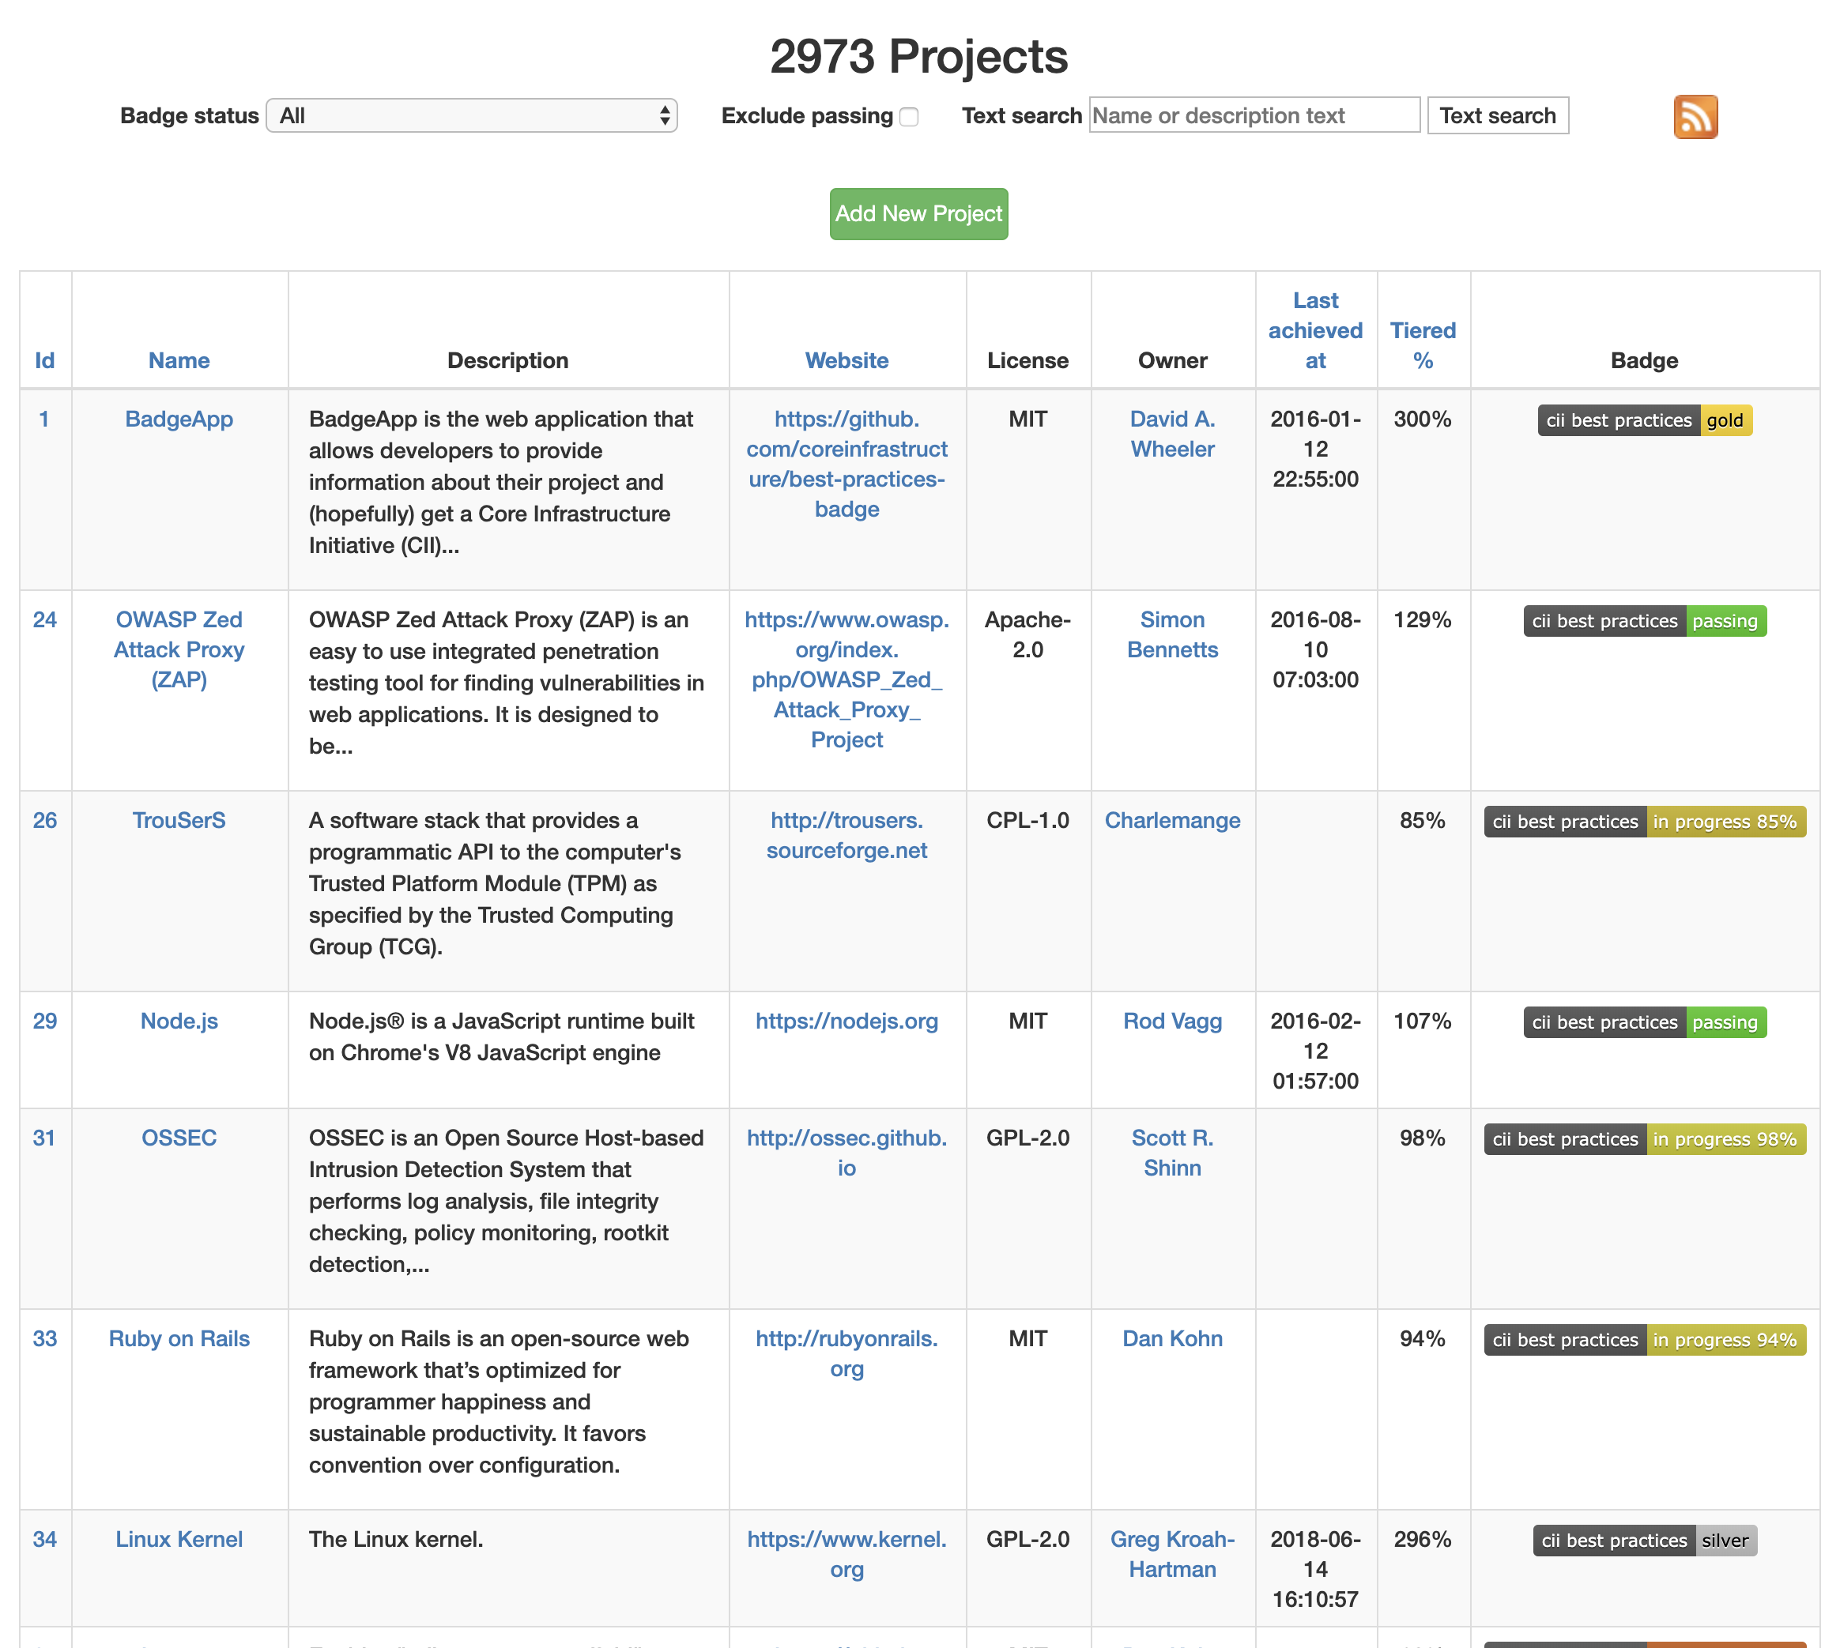

Slide 51
Linux Foundation - Trust and Security Initiative
Trust and Security Initiative
Eight Best Practices
Certification Scheme
Other Security Issues
Roles and Responsibilities
Security Policy
Know Your Contributors
The Software Supply Chain
Technical Security Guidance
Security Playbooks
Security Testing
Secure Releases and Updates
Based on Cloud Security Alliance or CSA STAR program models.
Security Build Certificate
Lack of good Open Source
Security Testing Tools
Open Source Package Distribution is a Risk to the Internet
Vulnerability Disclosure is Broken

Slide 52
Open Source Organizations
Choose Projects backed by reputable communities

Slide 53
Conclusion

Slide 54
Conclusion
Health and Security of FOSS Supply Chain
Global Demand for Open Source
Software Supply Chain
Challenges
Ongoing Efforts
The growing demand for innovation accelerating open source consumption.
Ensuring the health and security of FOSS Supply Chain is critical to the future of nearly all industries in the modern economy.
Increasing number of components
Transitive dependencies
Lack of security/quality controls across SSC
Government and Industry Standards
The Linux Foundation
Core Infrastructure Initiative
Trust and Security Initiative
Notes:
Software Supply Chain - Need to understand what components are being used, and how well they’re maintained.

Slide 55
References
Vulnerabilities in the Core: Preliminary Report and Census II of Open Source Software
2019 State of the Software Supply Chain
Open Source Software Supply Chain Security

